Slide 1


Table Reservation Management for Restaurants
Team Titan:
-Alok Ranjan Patel
-Palaniyappan

Slide 2
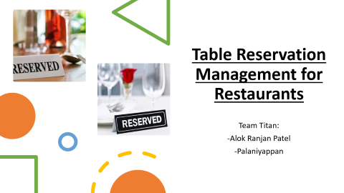
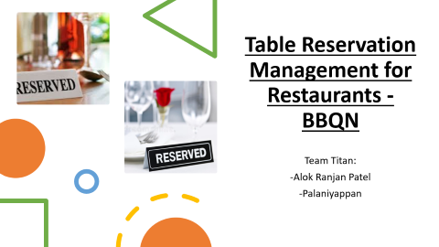
Aim and Approach
We have seen RPA altering industries drastically.
now the potential of RPA for hoteliers to innovate and deliver improved services, has gone sky high.
Our team took such tremendous potential scenario in the area of booking - hotel management.
aim is to take care of booking table, and enabling more time to care for guests.

Slide 3
AS IS Process - overview
Guest calls a person at restaurant and do the booking.
The person from restaurant will get the details one by one and do a data entry.
That data must be managed and modelled by hotel management team.
SMS must be sent to guest with their booking details.
Need to validate details on guest arrival.
1
5
2
4
3

Slide 4
To Be Process - Overview
Enabling GUEST TO LOOK FOR DIFFERENT OPTON AND GATHER DATA
Data is collected by bot and table reservation is done.
Data modelled with Data Service and kept intact.
SMS sent with the booking details
1
2
4
3

Slide 5


Guests will be given with options to book their table using UiPath Apps
Location list will be given as drop-down option
Guest selects the place and date
Bot will validate the date
Start
Date is wrong
True
False
UiPath Apps
UiPath apps will suggest to choose the right date
Bot will ask for lunch or dinner
UiPath Process Robot
Lunch
Dinning option
Dinner
If no slots available
True
Bot will look for Slots available
Bot will look for Dinner slots
User will be redirected to choose another slot
False
End
SMS will be sent with details
Mobile Number and OTP Validation
Click Reserve table
User will be given option to choose time slots

Slide 6
Challenges | Solutions
Gathering and manipulatin data accurately in short span of time | UiPath Apps gets the data and validate user request internally with help of BoT.
Hotel Internal Department to take guest request | Bot checks and initiate reservation as per user request
Internal team must check for data in their Reservation management system | Bot will validate and manage data with Data Service
Labour intensive as manual correlation of multiple data sources is required. | Bot does the transaction and maintain success degree to the max.
Team might miss 360-degree view of customers | Bot takes over and enabling 100% service to guests
Require multiple applications like web portal, external websites, data management system. | All in one roof – UiPath Services used – UiPath Data Services and UiPath Apps

Slide 7


